Slide 1
AN INTRODUCTION TO IDEAL (With paper planes)

Slide 3
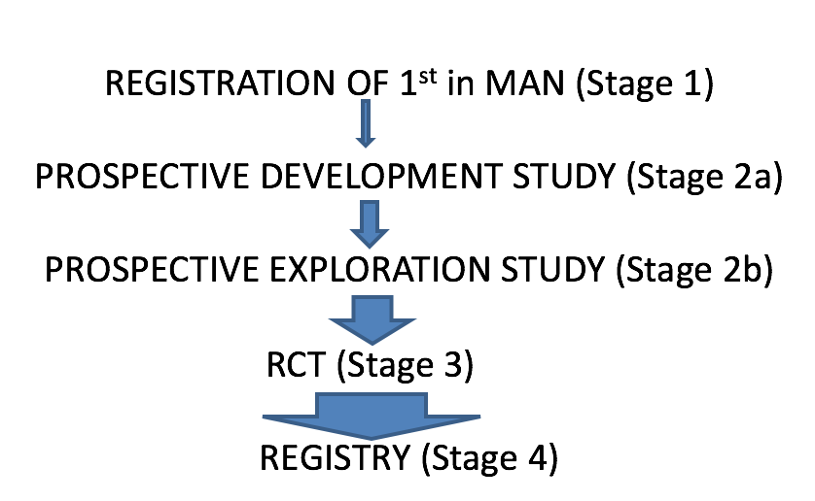
IDEAL: An integrated evaluation pathway for complex therapeutic interventions

Slide 4
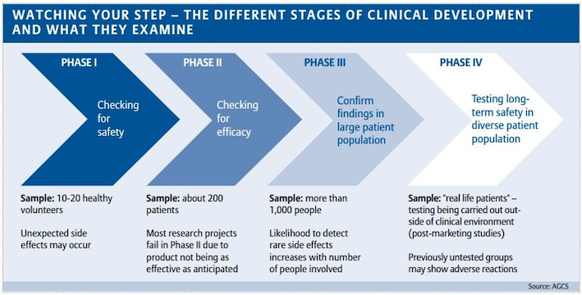
Phases of study – Pharma Trials

Slide 5
Interventional Treatments
1
SURGERY
2
INTERVENTIONAL CARDIOLOGY, RADIOLOGY
3
IMPLANTABLE DEVICES
4
ENDOSCOPIC THERAPY
5
PHYSIOTHERAPY

Slide 8
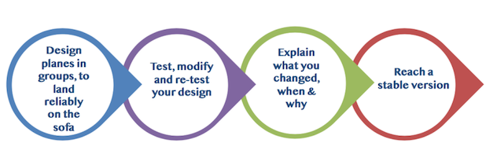
Paper plane design and evaluation

Slide 9
IDEAL Recommendations: Stage 1
All new first-in-human studies should be registered and be available for study by other clinical scientists
Description of patient selection, intervention technique and outcome should be detailed enough to allow repetition
Legal discovery protection should be provided to permit registration of unsuccessful innovations

Slide 10
IDEAL Recommendations: Stage 2a
Detailed technical description of procedure
Detailed description of patient selection criteria
Description of ALL modifications, when made in the series, and why
Prospective account of ALL cases consecutively showing results

Slide 11
What next, now that the intervention is stable?

Slide 12
Remaining problems testing planes
Variable definition of a paper plane
Variability in delivery – thrower quality – including Learning Curves
Widening indications – adding weight to the plane
Disagreement about what the RCT question should be

Slide 13
IDEAL Recommendations: Stage 2b COLLABORATIVE PROSPECTIVE COHORT STUDY
To agree procedure definition, quality standards & patient selection criteria
To examine differential outcomes in pre-specified sub-groups
To evaluate learning curves
To evaluate preferences and values amongst patients and clinicians
To achieve consensus on future trial question and comparator

Slide 14
IDEAL Stages 3 and 4

Slide 15
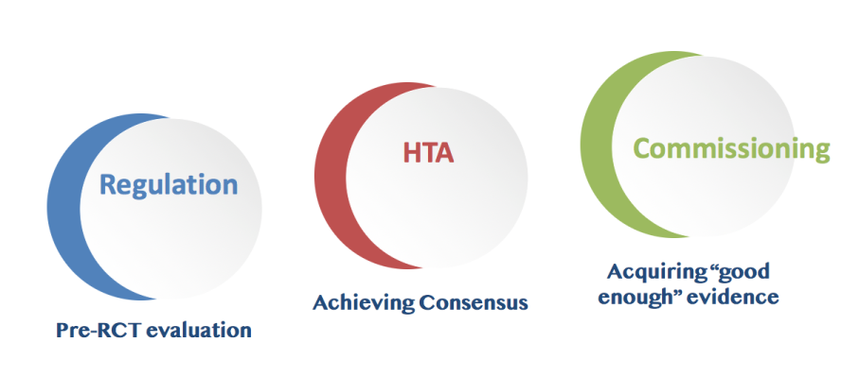
Potential value of IDEAL

Slide 16
Summary and Usefulness

Slide 17
Get involved
www.ideal-collaboration.net
Follow us on Twitter @IDEALCollab
Use our Advisory Service on setting up and conducting IDEAL studies
Become a member and subscribe to our newsletter
Collaborate on piloting & evaluating IDEAL study designs
Contact: allison.hirst@nds.ox.ac.uk
IDEAL Project Manager

